Slide 1
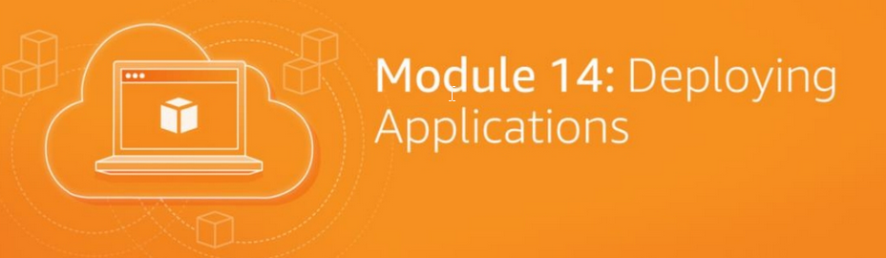
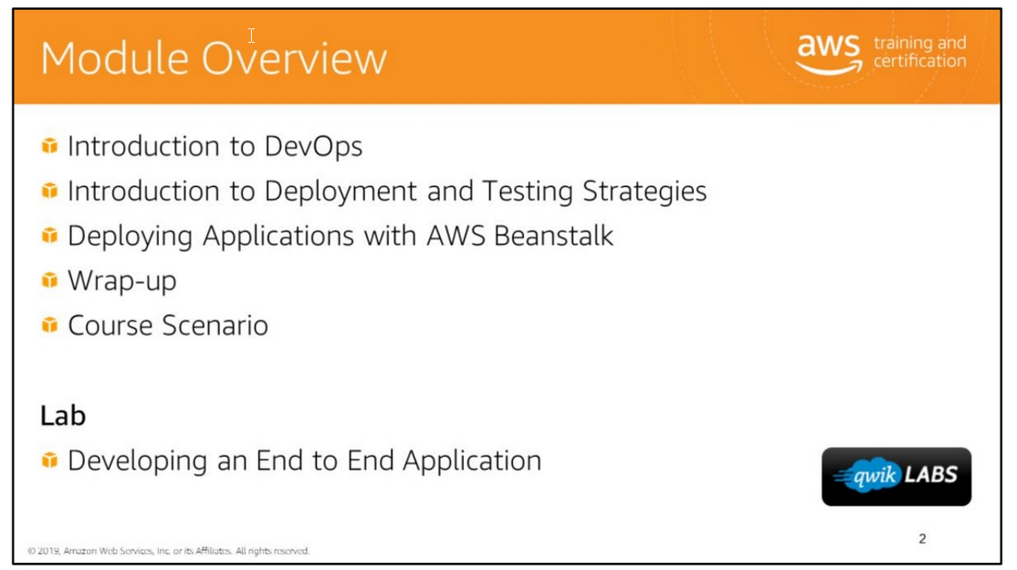

Slide 2


Slide 3
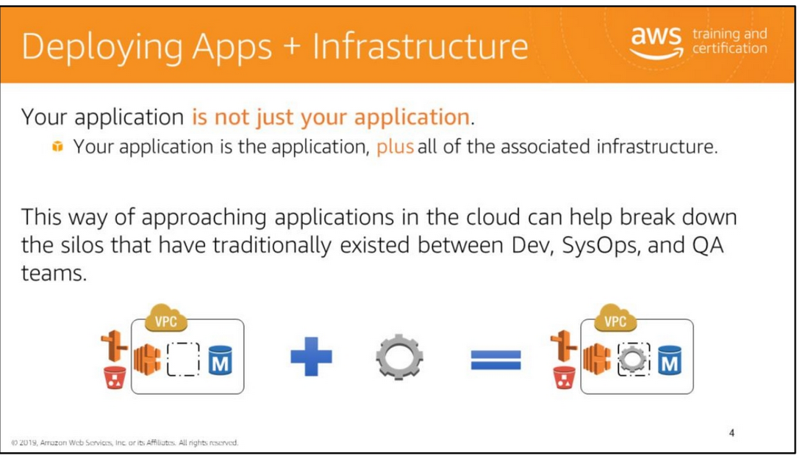
In the cloud, your application is not just your application. Your application is your application plus all of the associated infrastructure required to run it.
This can include VPCs, load balancers, Auto Scaling groups, Amazon RDS databases, Amazon S3 buckets and their associated data,
servers, anything in AWS (and beyond) that your application depends on to function correctly.
This is a different way of thinking than some developers might be used to.
Until the past 20 years or so, developers and system administrators were seen as having distinct jobs, and the two teams often worked in silos.
This led to the phenomenon of developers "throwing applications over the wall" to the system administration team;
developers would ensure that applications worked in their dev environments, but would leave it to system administrators to set up the corresponding environment properly in production.
This disconnected approach results in a lot of expensive, time-consuming conversation between the two teams as the SysOps teams struggle to host whatever the development team creates
in a scalable, secure manner. The Agile and DevOps movements have worked to close this gap between the Dev and SysOps teams.
Deploying applications in the cloud helps break down these traditional silos.
In a traditional data center platform, it can be prohibitively expensive for a Dev team to build out an architecture similar to one that exists in the production environment.
In the cloud, Dev teams have the tools they need to provision their own infrastructure, to test that infrastructure at scale, and to turn off that infrastructure when it's not in use.
This allows developer teams to create environments that are similar (or, even better, identical) to the environment that their application will run in when it is deployed to production.

Slide 4
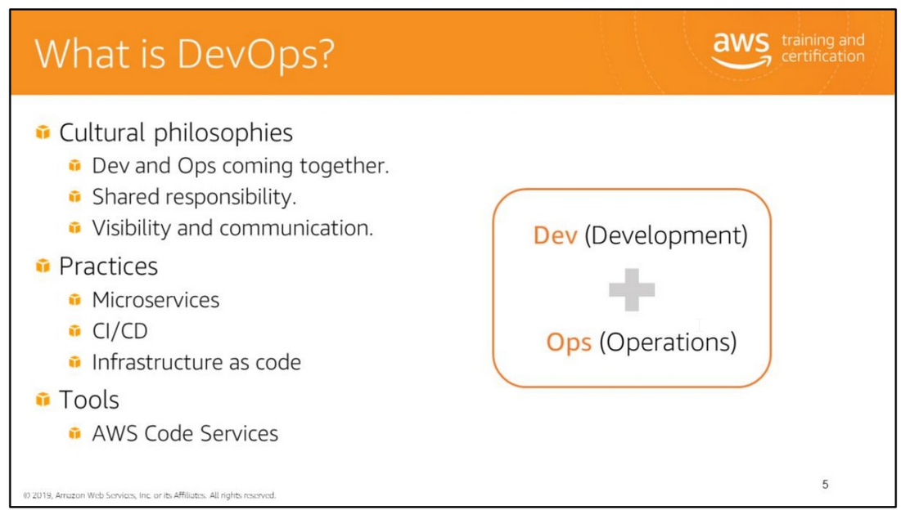
Under a DevOps model, development and operations are no longer siloed.
Sometimes, these two functions are merged into a single team where engineers work across the entire application lifecycle, from development and test to deployment to operations,
and develop a range of skills not limited to a single function. Quality assurance and security teams may also become more tightly integrated with development and operations throughout
the application lifecycle.
The speed enables organizations to better serve their customers and compete more effectively in the market.
Good DevOps practices encourage software development engineers and operations professionals to work better together.
This results in closer collaboration and communication, leading to shorter time to market, better code quality and maintenance, and more reliable release

Slide 5
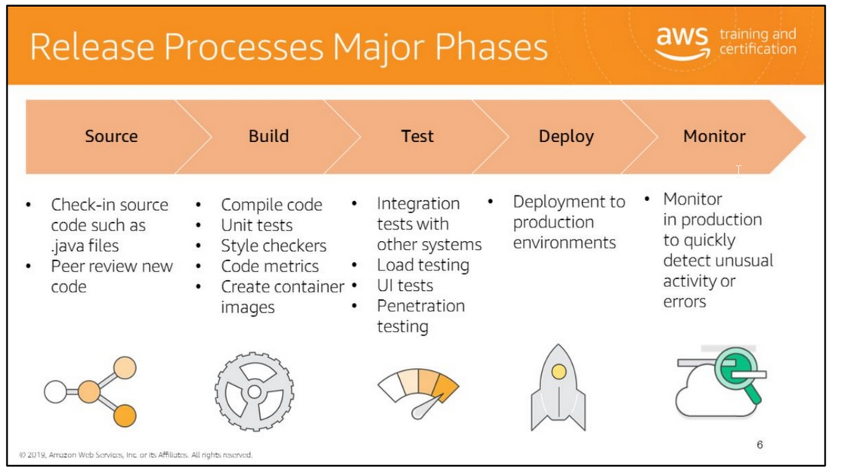
Nearly all release processes can be simplified down to five stages – source, build, test, production, and monitor.
Each phase of the process provides increase confidence that the code being made available to customers will work in the way that was intended.
• During the source phase, developers check changes into a source code repository. Many teams require peer feedback on code changes before shipping code into production.
Some teams use code reviews to provide peer feedback on the quality of code change. Others use pair programming as a way to provide real time peer feedback.
• During the Build phase an application’s source code is built and the quality of the code is tested on the build machine.
The most common type of quality check are automated tests that do not require a server in order to execute and can be initiated from a test harness.
Some teams extend their quality tests to include code metrics and style checks. There is an opportunity for automation any time a human is needed to make a decision on the code.
• The goal of the test phase is to perform tests that cannot be done on during the build phase and require the software to be deployed to a production like stages.
Often these tests include testing integration with other live systems, load testing, UI testing and penetration testing. At Amazon we have many different pre-production stages we deploy to.
A common pattern is for engineers to deploy builds to a personal development stage where an engineer can poke and prod their software running in a mini prod like stage
to check that their automated tests are working correctly.
Teams deploy to pre-production stages where their application interacts with other systems to ensure that the newly changed software work in an integrated environment.
• Finally code gets deployed to production. Different teams have different deployment strategies though we all share a goal of reducing risk when deploying new changes and minimizing
the impact if a bad change does get out to production.
• You then need to monitor in production to determine any issues that you may encounter. Each of these steps can be automated without the entire release process being automated

Slide 6
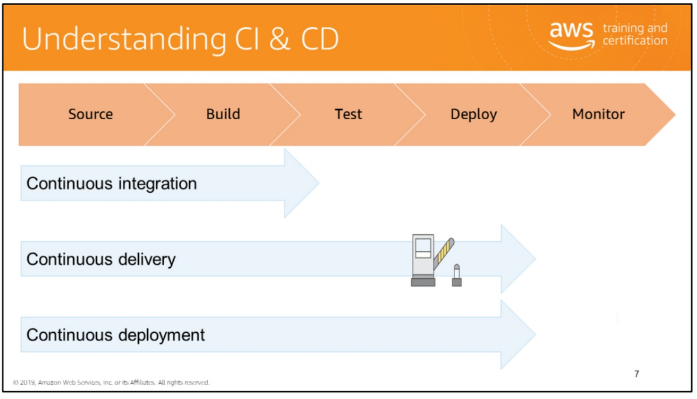
Continuous Integration
Continuous Integration is the practice of checking in your code to the continuously and verifying each change with an automated build and test process.
Over the past 10 years Continuous Integration has gained popularity in the software community.
In the past developers were working in isolation for an extended period of time and only attempting to merge their changes into the mainline of their code once their feature
was completed. Batching up changes to merge back into the mainline made not only merging the business logic hard, but it also made merging the test logic difficult.
Continuous Integration practices have made teams more productive and allowed them to develop new features faster.
Continuous Integration requires teams to write automated tests which, as we learned, improve the quality of the software being released and reduce the time it takes to validate
that the new version of the software is good. There are different definitions of Continuous Integration, but the one we hear from our customers is that CI stops at the build stage.
Continuous Delivery
Continuous Delivery extends Continuous Integration to include testing out to production-like stages and running verification testing against those deployments.
Continuous Delivery may extend all the way to a production deployment, but they have some form of manual intervention between a code check-in and when that code is available
for customers to use.
Continuous Delivery is a big step forward over Continuous Integration allowing teams to be gain a greater level of certainty that their software will work in production.
Continuous Deployment
Continuous Deployment extends continuous delivery and is the automated release of software to customers from check in through to production without human intervention.
Many of the teams at Amazon have reached a state of continuous deployment.
Continuous Deployment reduces the time for your customers to get value from the code your team has just written, with the team getting faster feedback on the changes you’ve made.
This fast customer feedback loop allow you to iterate quickly, allowing you to deliver more valuable software to your customers, quicker

Slide 7
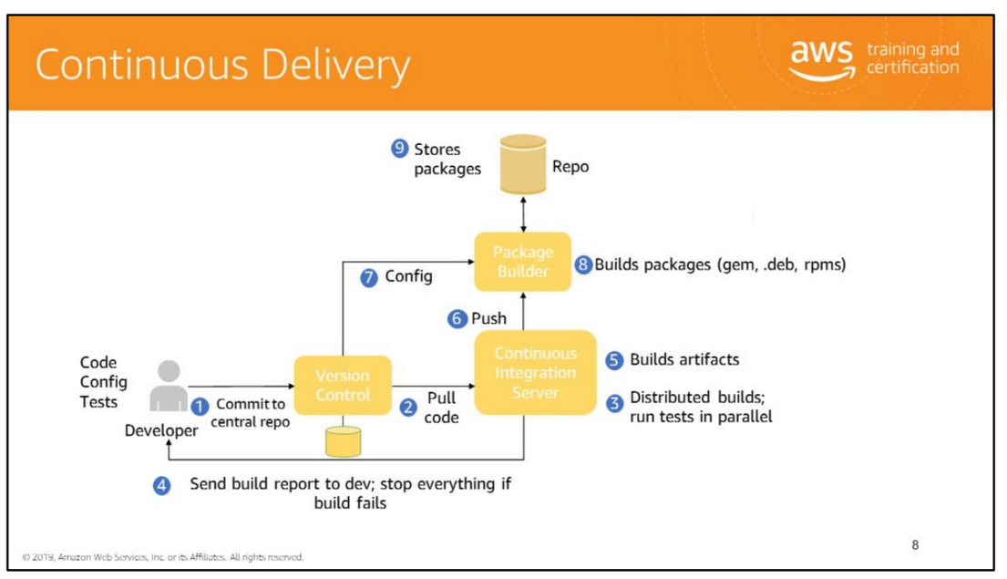

Slide 8
Continuous integration helps developers verify the continued quality of their code base.
Continuous delivery verifies the suitability of a build for release to production; if a build passes, it can be released immediately. Successful continuous integration
enables successful continuous delivery and deployment.
Architecture for Cloud Continuous Integration
Developer commits changes to the central repo. Pre-commit hooks should run and verify that the code meets specified requirements.
2. A CI server pulls the changes from the central repo and builds the code.
3. The CI server runs all required tests against the new branch or mainline change.
4. The CI server returns a report to developer and stops the build job if a failure occurs.
Note Reports should also be stored in a log somewhere that is accessible to all stakeholders
5. If the changes pass the required tests, the CI server builds the artifacts.
6. The CI server pushes artifacts to the package builder.
7. The package builder gets configuration information from the version control system.
8. The package builder uses the configuration information and the artifacts to build the specified packages (gem, .deb, rpms..).
9. The packages are stored in a repository.
10. The repo uses a post-receive hook to deploy specific packages to staging.
This is, of course, not a required workflow; this is merely one example of how you could configure a continuous integration system if it suited your development process.
If a broken build makes it through your tests but is discovered later, prevent any further changes or pulls from your mainline until the problem is fixed; otherwise,
the problem will appear in subsequent work by other developers. Additionally, you can add another test to prevent these bugs from making it into the mainline in the future.
Do not fear rollbacks. Errors will happen, mistakes will be made, and the benefit of employing version control systems is that when appropriate, you can always revert to a previously
working state and save yourself the time and effort of trying to debug

Slide 9
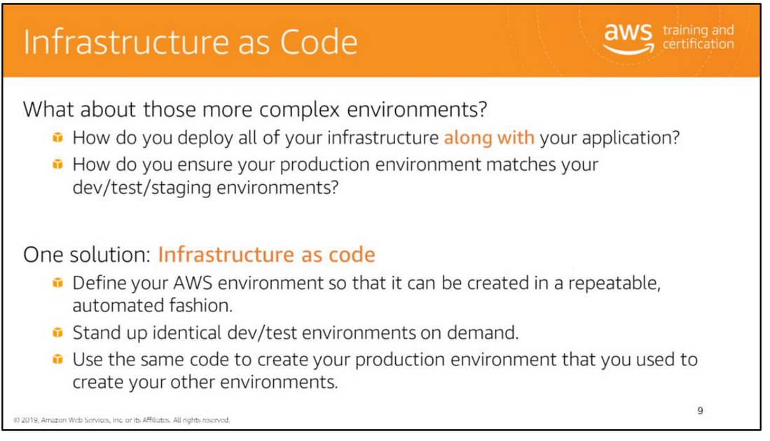
There are two key questions. First, how do you provision all of this infrastructure?
Second, how do you provision it so that what runs in your production environments matches what runs in your dev, test, and staging environments?
As you've seen in this course, nearly everything that you can create in AWS through the Management Console can be created by using a programmatic SDK
or the AWS Command Line Interface (CLI). You can leverage this capability to define your infrastructure as a series of scripts or other code artifacts.
This enables you to create your infrastructure automatically and in a repeatable fashion.
This makes it possible to create multiple environments—dev, test, staging, and production—all from the same codebase.
At AWS, we call this capability infrastructure as code.

Slide 10
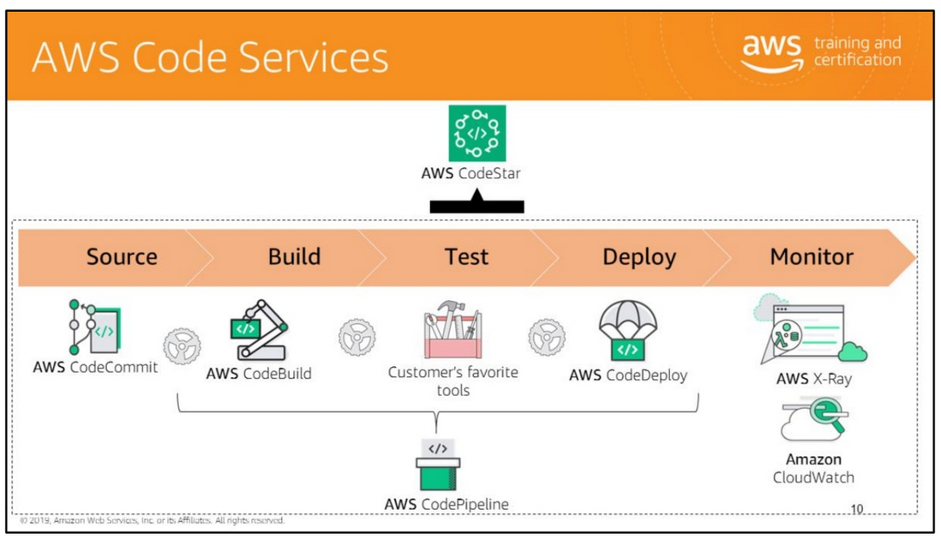

Slide 11
AWS CodeStar
AWS CodeStar enables you to quickly develop, build, and deploy applications on AWS.
AWS CodeStar provides a unified user interface, enabling you to easily manage your software development activities in one place.
With AWS CodeStar, you can set up your entire continuous delivery toolchain in minutes, allowing you to start releasing code faster. AWS CodeStar makes it easy for your whole team
to work together securely, allowing you to easily manage access and add owners, contributors, and viewers to your projects.
AWS CodePipeline
Continuous delivery service for fast and reliable application updates. It allows you model and visualize your software release process.
Builds, tests, and deploys your code every time there is a code change. Integrates with third-party tools and AWS.
AWS CodeCommit
CodeCommit enables you to privately store and manage your assets (such as documents, source code, and binary files) in the cloud. AWS CodeCommit is a secure, highly scalable,
managed source control service that hosts private Git repositories.
AWS CodeBuild
CodeBuild compiles source code, runs tests, and produces software packages that are ready to deploy. No need to manage build servers.
AWS CodeDeploy
Automates code deployments to any instance.
Handles the complexity of updating your applications. Avoid downtime during application deployment.
Deploy to Amazon EC2 or on-premises servers, in any language and on any operating system. Integrates with third-party tools and AWS.
AWS X-Ray
AWS X-Ray helps developers analyze and debug production, distributed applications, such as those built using a microservices architecture.
With X-Ray, you can understand how your application and its underlying services are performing to identify and troubleshoot the root cause of performance issues and errors.
Amazon CloudWatch
Gaining visibility across your distributed stack means correlating and visualizing metrics and logs to quickly pinpoint and resolve issues.
With Amazon CloudWatch, you can visualize key metrics like CPU utilization and memory.

Slide 12
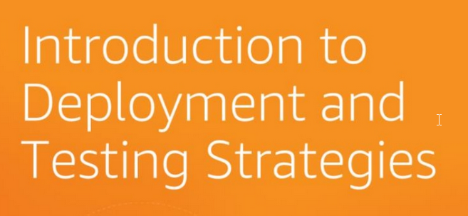

Slide 13
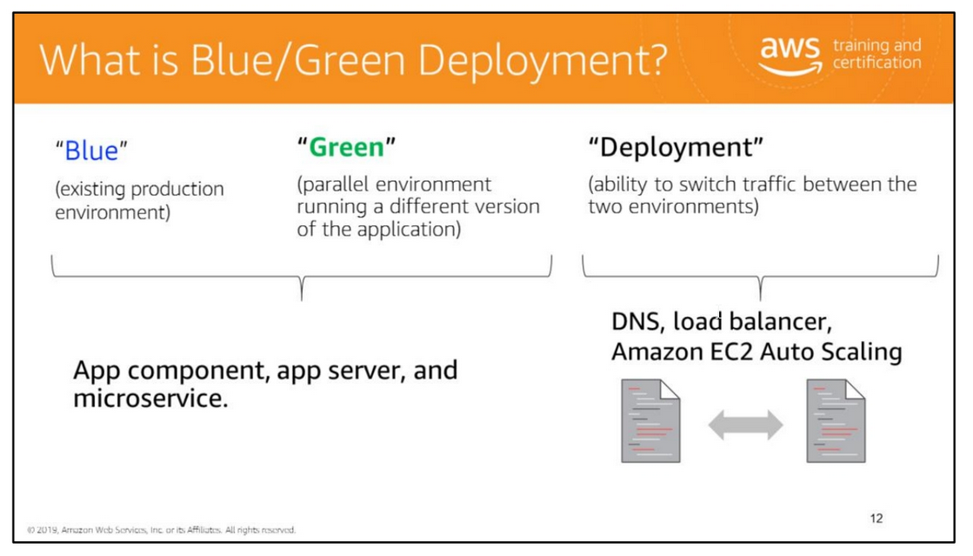
The idea behind blue/green is simple:
• Your blue environment is your existing production environment carrying live traffic.
• In parallel, you provision a green environment, which is identical to the blue environment other than the new version of your code.
When it’s time to deploy, you route production traffic from the blue environment to the green.
If you encounter any issues with the green environment, you can roll it back by reverting traffic back to the original blue environment. DNS cutover and swapping auto-scaling groups
are the two most common methods used to re-route traffic in blue/green.

Slide 14
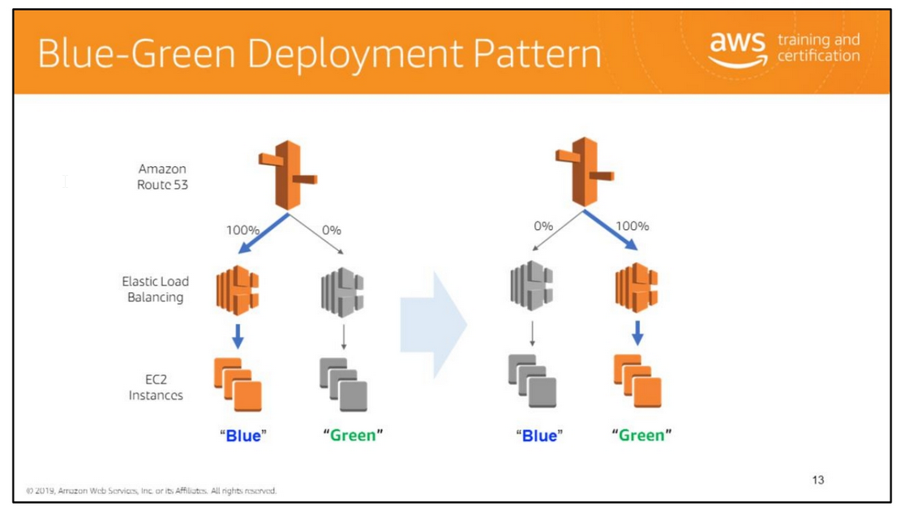
Stand up a new environment, and switch over using Amazon Route 53.
When you stand up a parallel environment, you can use Amazon Route 53 to gradually shift traffic over from the old stack (represented by its public-facing load balancer) to the new stack.
If a problem or series of failures is detected in the new stack, you can halt the migration and move all traffic back to the existing stack.
If the migration is completed successfully, you can delete the old stack.
If you use AWS CloudFormation, simply make a single call to the AWS CLI or a language-specific SDK to delete the stack, which will automatically delete all associated resources
in the correct order.

Slide 15
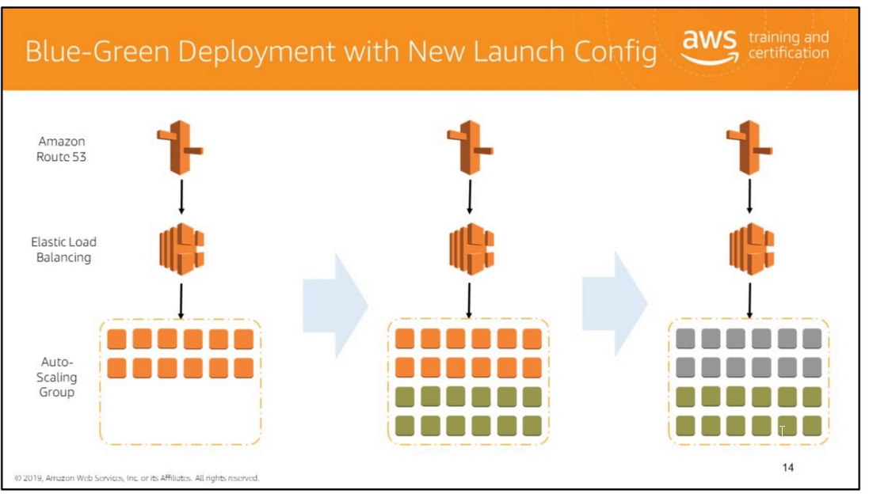
Another way to transition between versions is to modify the launch configuration of your Auto Scaling group.
In this scenario, you would define a new launch configuration in your AWS CloudFormation template and then update your AWS CloudFormation stack.
You would also set the termination policy for the Auto Scaling group to ensure that the instances with the oldest launch configuration are terminated first.
For more information, see http://docs.aws.amazon.com/AutoScaling/latest/DeveloperGuide/AutoScalingBehavi or.InstanceTermination.html.
You request that the Auto Scaling group be set to double its usual capacity, which causes several new instances to be created next to the old instances.
After you ensure that the new instances are running and receiving traffic, set the Auto Scaling group back to its original desired capacity, which causes the old instances to be terminated
in accordance with the termination policy that you set. This is a very simple way to update an application version that doesn't require re-provisioning an application's entire infrastructure.
You have to be careful, however, to set up monitoring so that you can verify that the new instances are healthy.
This can be done by tracking the instance's ELB health check results and by using CloudWatch Logs to stream the logs of the new application version to a separate log stream

Slide 16
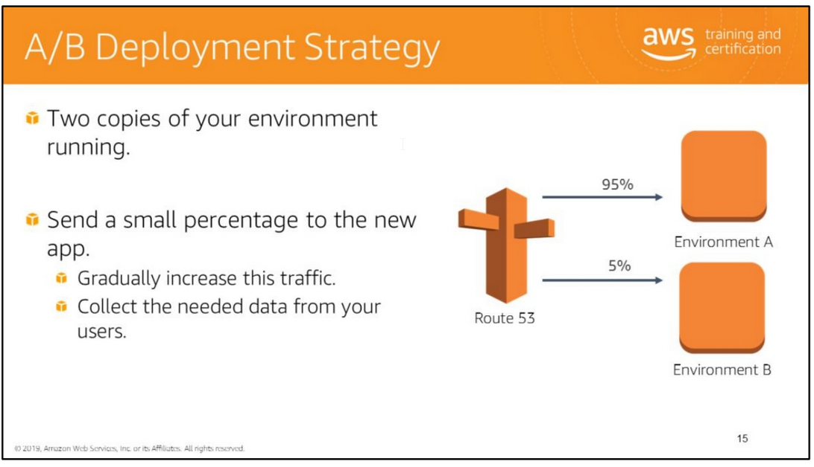
In A/B, the deployment strategy works much like blue/green in that you have two copies of your environment running.
You might choose to send a small percentage of your total traffic to the new app, perhaps to capture user feedback about the changes, or to ensure that no scaling issues were introduced
in this new release. You can gradually increase this traffic, or just collect the needed data from your users. Amazon Route 53 can implement this deployment strategy with WRR

Slide 17
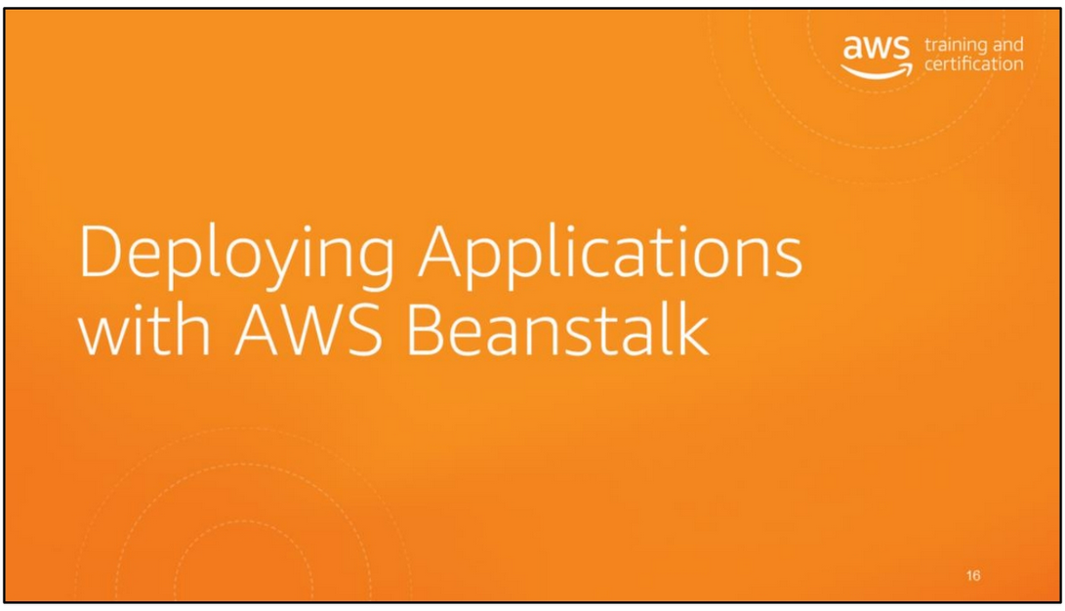

Slide 18
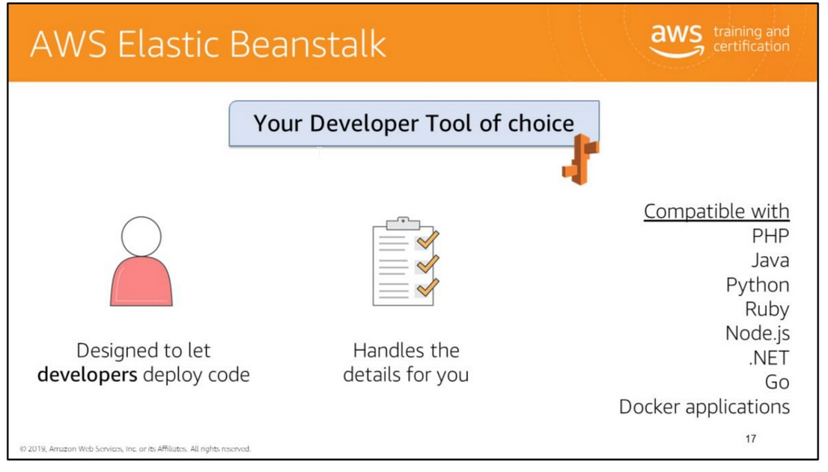
A good way to get started with application deployment on the AWS platform is by using AWS Elastic Beanstalk.
Using Elastic Beanstalk confers a number of advantages for developers new to the AWS platform.
Elastic Beanstalk provides a wrapper for several lower-level AWS services, including Amazon EC2, Amazon CloudWatch, Auto Scaling, and Elastic Load Balancing. Using Elastic Beanstalk,
you can select the application environment you want to use (e.g., PHP, Perl, or Ruby), select the application package you want to deploy, and select how you want the application to scale.
Elastic Beanstalk handles the details of creating and connecting the various components required by your application, such as load balancers and auto scaling groups.
Elastic Beanstalk allows you to deploy an application quickly while retaining as much control as you wish to have over the underlying infrastructure.
Developers can simply upload their application code and the service automatically handles all the details such as resource provisioning, load balancing, auto-scaling, and monitoring.
Elastic Beanstalk is ideal if you have a standard PHP, Java, Python, Ruby, Node.js, .NET, Go, or Docker application that can run on an app server with a database.
Elastic Beanstalk uses Auto Scaling and Elastic Load Balancing to easily support highly variable amounts of traffic. You can start small and scale up.

Slide 19
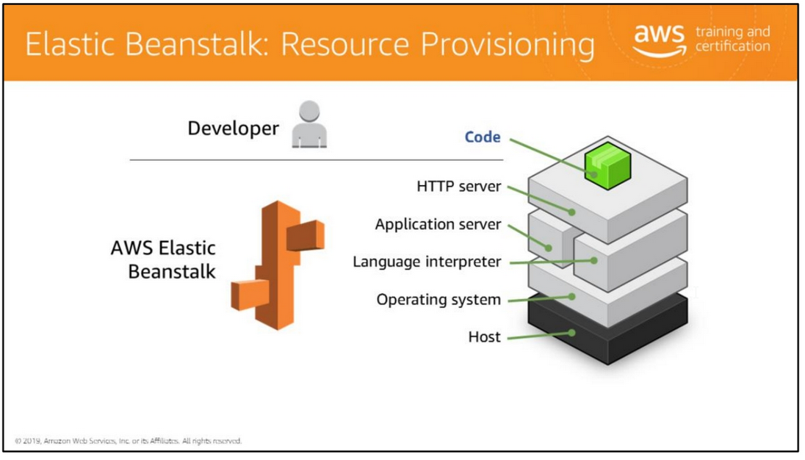
The goal of AWS Elastic Beanstalk is to help developers to deploy and maintain scalable web applications and services in the cloud without having to worry about the underlying infrastructure.
Elastic Beanstalk configures each EC2 instance in your environment with the components necessary to run applications for the selected platform.
You don’t have to worry about logging into instances to install and configure your application stack

Slide 20
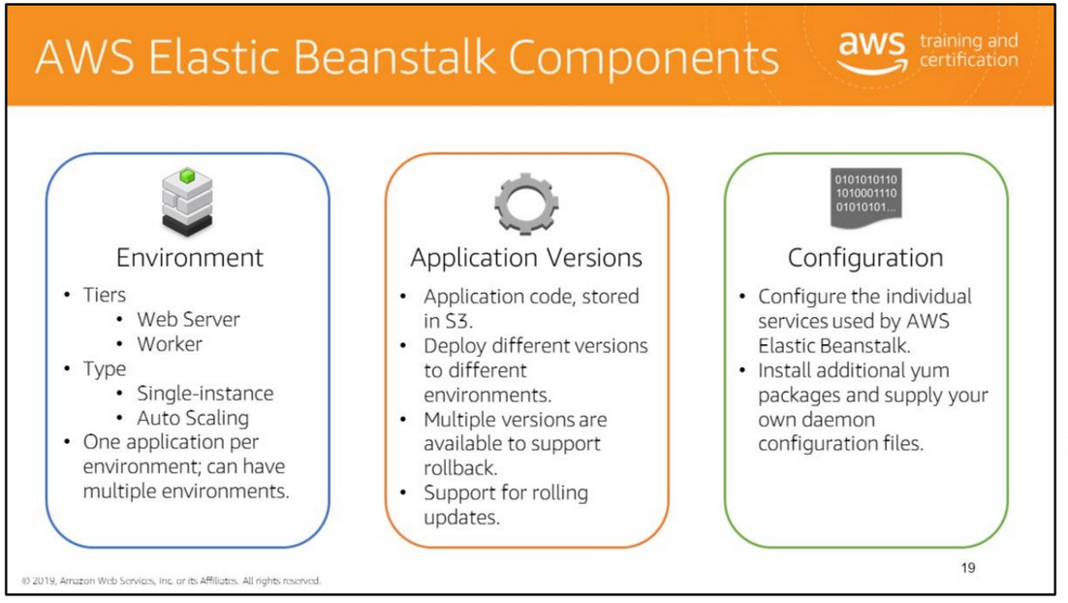
There are three critical elements to understand in AWS Elastic Beanstalk:
Environment
The infrastructure that supports your application. An environment can be either a Web Server tier
or a Worker tier. The Worker tier is a background (non-interactive) application that typically processes some sort of queued request, such as messages sent to an Amazon SQS queue.
An environment can also be either a single instance environment or an Auto Scaling group with an Elastic Load Balancing load balancer in front of it.
You can configure your AWS Elastic Beanstalk application to maintain Auto Scaling groups in multiple subnets in order to distribute traffic across Availability Zones.
Versions
A specific release of your application. New versions of your application can be released onto an existing stack in a rolling update.
You can specify that a new application version is distributed to a certain percentage of your fleet at the same time or that instances are updated individually.
Configuration
The set of customizations to apply to your environment. The type of customization that you can perform is specific to the environment you choose and to the
language/programming framework used by your application

Slide 21
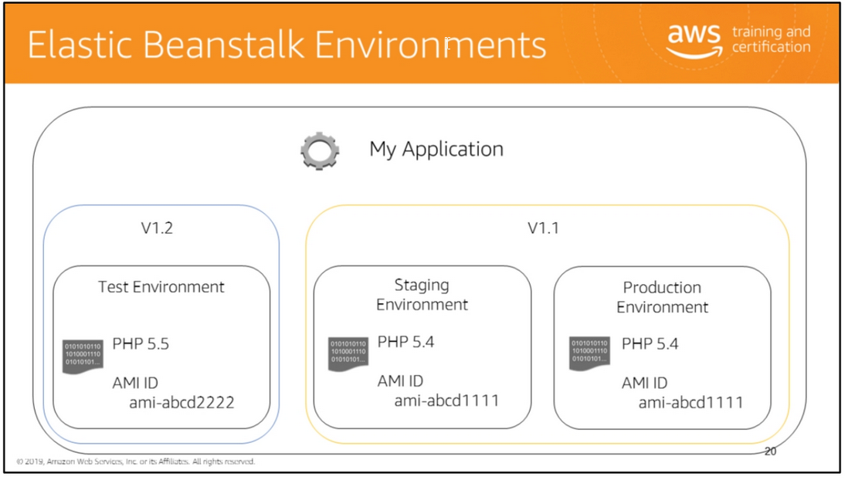
Let's try to concretize the relationship between application, environments, and configurations a little better.
In this example, there are three environments—test, staging, and production—each configured to use a custom AMI on its underlying Amazon EC2 instances.
Having multiple environments per application allows you to run your production system on the known good version of your application while you test both a new version of the application and the new underlying AMI required to support it

Slide 22
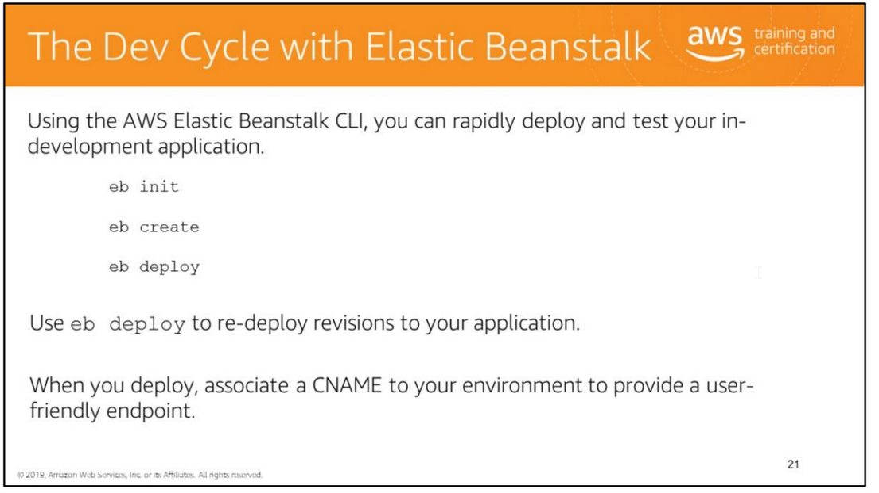
How do you actually get started with AWS Elastic Beanstalk? If you install the AWS Elastic Beanstalk command line utilities (see the instructions on this page:
http://docs.aws.amazon.com/elasticbeanstalk/latest/dg/eb-cli3-install.html), you can get started by just opening a command line prompt on your computer,
navigating to the directory that contains your application's source code, and using the following commands:
eb init: Initializes your application to use AWS Elastic Beanstalk.
This creates a .elasticbeanstalk folder with a config.yml file in your directory with information about your application and its environment.
2. eb create: Creates and starts an AWS Elastic Beanstalk application with the specified DNS endpoint.
3. eb deploy: Deploys the most recent version of your application. As you make revisions to your application,
you can run eb deploy to rapidly update and test the changes in your existing AWS Elastic Beanstalk application.
These commands take several arguments; however, if you do not specify any arguments for these commands,
The Elastic Beanstalk CLI will prompt you for key values it requires, such as the name of the key pair you want to use and the name to use for your environment.
Note that Elastic Beanstalk also offers Git integration and provides the ability to launch a application from a specific Git branch.
This means that you can create a branch, make a series of changes, and then immediately test your changes in a live environment using the Elastic Beanstalk CLI commands.
For more information on initializing your local development environment with AWS Elastic Beanstalk, see
http://docs.aws.amazon.com/elasticbeanstalk/latest/dg/chapter-devenv.html.

Slide 23
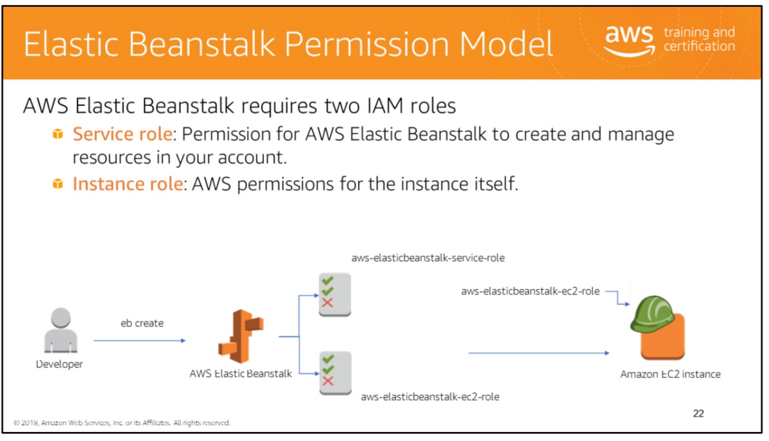
An IAM role is similar to a user: it is an AWS identity with permission policies that determine what the identity can and cannot do in AWS.
However, instead of being uniquely associated with one person, a role can be assumed by anyone who needs it.
A role can have one or more IAM policies attached to it; these policies determine what can or cannot be done by users and other entities who use (or assume) this role.
In order to work properly, AWS Elastic Beanstalk must create two roles.
• The service role gives Elastic Beanstalk the permission to create and manage AWS resources in your account.
This permission is required for the AWS Elastic Beanstalk service to create Amazon EC2 instances, Auto Scaling groups, and the other resources it requires to deploy your application.
• The instance role is used by Elastic Beanstalk as the role into which your instance is launched.
Roles can be assumed by users, and they can also be assigned to instances instead of placing hard-coded permissions (in the form of access keys and secret keys) on the instance.
When you create a role, AWS also creates an entity called an instance profile, which is associated with your instance when it launches.
AWS Elastic Beanstalk will create these roles for you, if you don't supply them.

Slide 24
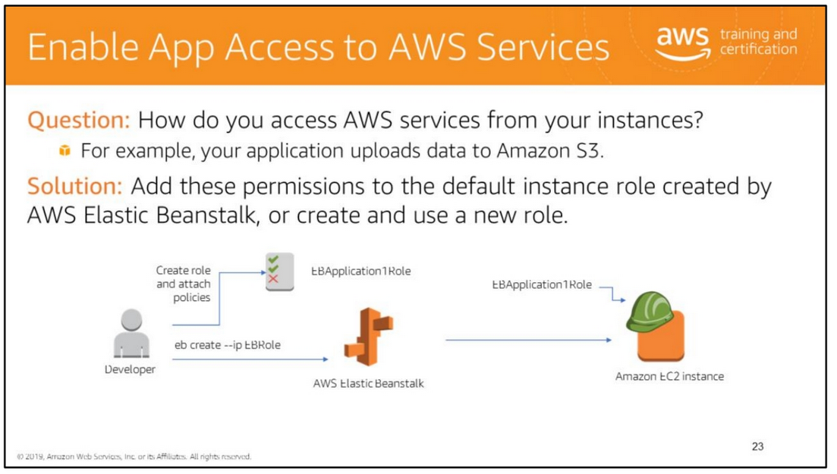
The slide shows a very simple application that doesn't integrate with any other AWS services.
But what if you have an application that accepts document uploads as part of a form submission and needs to upload to an Amazon S3 bucket?
What if you need to read to and write data from a set of Amazon DynamoDB tables?
One solution is to find a way to put AWS credentials on each instance created by AWS Elastic Beanstalk.
While possible, it's not the most secure way to grant permissions to an instance.
The preferred method is to use roles and instance profiles in IAM.
Whenever you create a role in AWS, IAM automatically creates an instance profile of the same name.
You can pass the name of the instance profile to eb create using the - -ip argument.
This will tell AWS Elastic Beanstalk to launch your Amazon EC2 instances into that profile.
Any code that executes on that instance will have the permissions to AWS services that are granted by the policies attached to the role

Slide 25
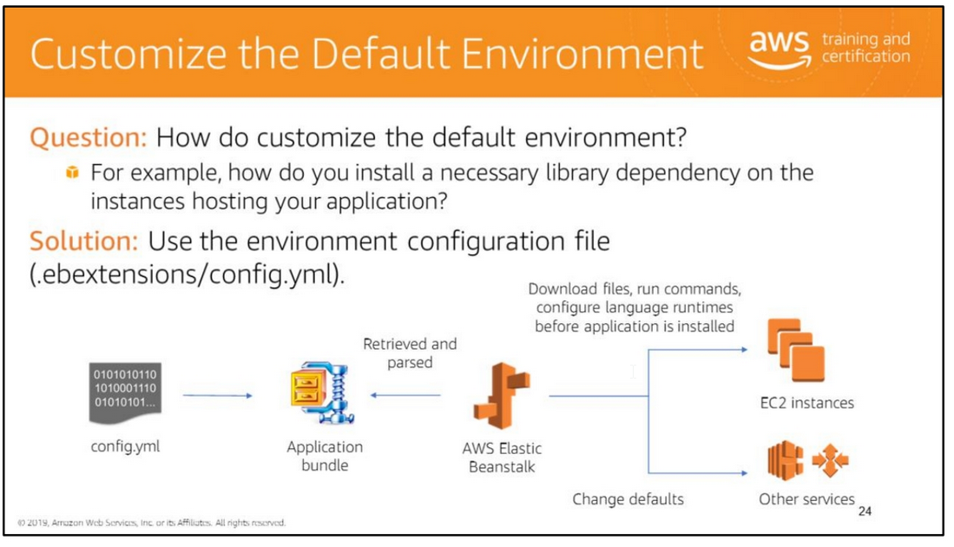

Slide 26
That solution is good if you only need the default environment. But what if you have a more complex application?
For example, what if you have built a Ruby application that requires multiple gemfiles?
Or what if you need to tweak the default settings that AWS Elastic Beanstalk applies to your load balancer?
The .elasticbeanstalk/config.yml file that was created when you ran eb init is your project's environment configuration file: a YAML formatted file that supports a large number of options
for configuring your default environment. These options include:
• Configuring repo packages, installing external packages, downloading files, and executing commands on the instances that host your application.
• Configuring the defaults used by AWS Elastic Beanstalk services.
• Configuring your application's run-time environment (e.g., target runtime for .NET Framework applications and DB connection strings and credentials)
• Configuring your application to use HTTPS.
The config.yml file is bundled up with your application when you deploy it to your AWS Elastic Beanstalk environment.
Elastic Beanstalk reads this file and uses the settings to configure your instances and related services
Configuration options can be changed and re-applied to a running application by re-uploading the source bundle with a new version of the config.yml file.
You can also create a saved configuration in AWS Elastic Beanstalk and apply this saved configuration to a specified environment.
Configurations can be managed and applied by using the eb config command.
For a list of sub-commands, see http://docs.aws.amazon.com/elasticbeanstalk/latest/dg/eb3-config.html.
For more information, see:
• Customizing Software on Linux Servers: http://docs.aws.amazon.com/elasticbeanstalk/latest/dg/customize-containers-ec2.html
• Customizing Software on Windows Servers : http://docs.aws.amazon.com/elasticbeanstalk/latest/dg/customize-containers-windows-ec2.html

Slide 27
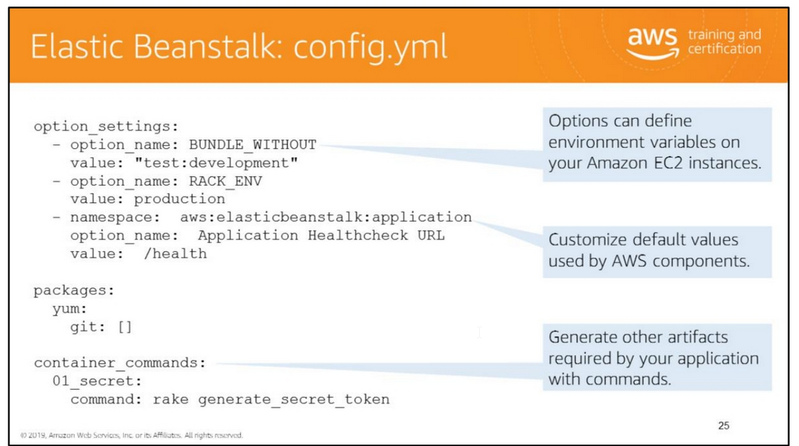
This slide shows a small snippet (taken from here: https://ruby.awsblog.com/post/Tx2AK2MFX0QHRIO/Deploying-Ruby-Applications-to-AWS-Elastic-Beanstalk-with-Git) that defines some
custom options for a Ruby on Rails application.
Option settings enable you to define two types of values for your application environment.
The first values are arbitrary or application platform–specific options that will be defined as environment variables on your Amazon EC2 instances.
These can be used to assist your application in retrieving certain values at run time, such as which database endpoint to use.
The second values are options that apply to other components in your application stack, such as your load balancing and Auto Scaling group.
These options consist of a namespace name, an option name, and a value.
For a list of all available namespaces and configuration options, see http://docs.aws.amazon.com/elasticbeanstalk/latest/dg/command-options.html

Slide 28
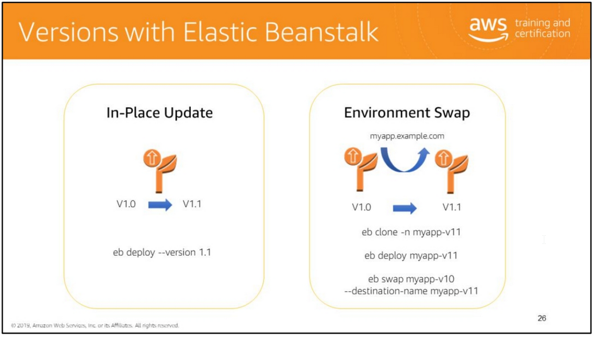
When updating an application, you have a couple of options. The first is to perform an in-place update. At its simplest (e.g., a point release), this involves just deploying a new version to your
existing stack. Using the eb deploy command, you can deploy the latest version of the source code in your code repository, apply a label to it, and deploy the new version to your existing stack.
Another option to switch an environment with zero downtime is to deploy to a new environment using the eb clone feature, which creates an exact clone of your existing stack.
When the new environment is up and you have deployed your new application version to it, you can use the URL to the stack provided by AWS Elastic Beanstalk to verify that it is up and running
and behaving as expected. You can then use the eb swap command to swap the CNAME from your running stack to the new stack and cut all users over to the new version.
For more information, see http://docs.aws.amazon.com/elasticbeanstalk/latest/dg/using-features.CNAMESwap.html.

Slide 29

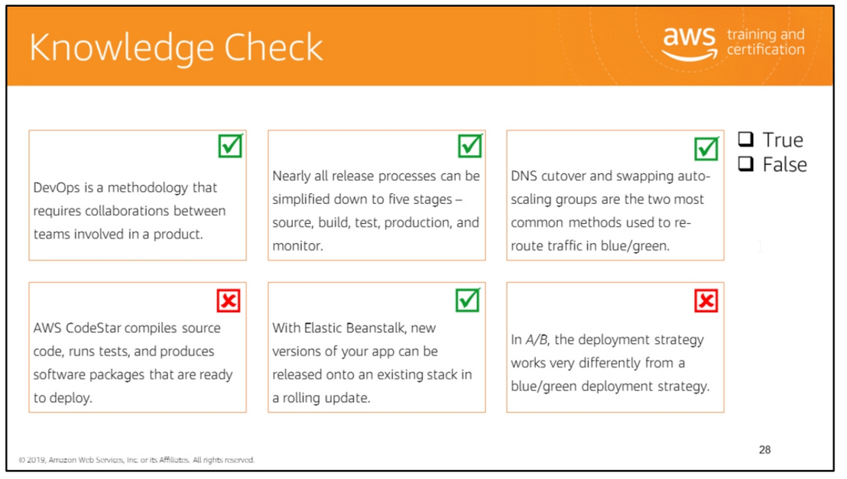
Read left to right:
(True)
(True)
(True)
(False) AWS CodeBuild compiles source code, runs tests, and produces software packages that are ready to deploy, not AWS CodeStar.
(True)
(False) In A/B, the deployment strategy works much like blue/green in that you have two copies of your environment running.

Slide 30

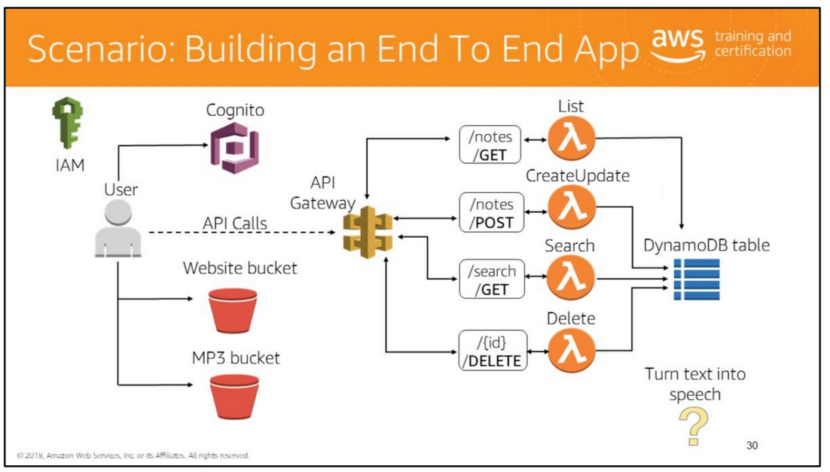
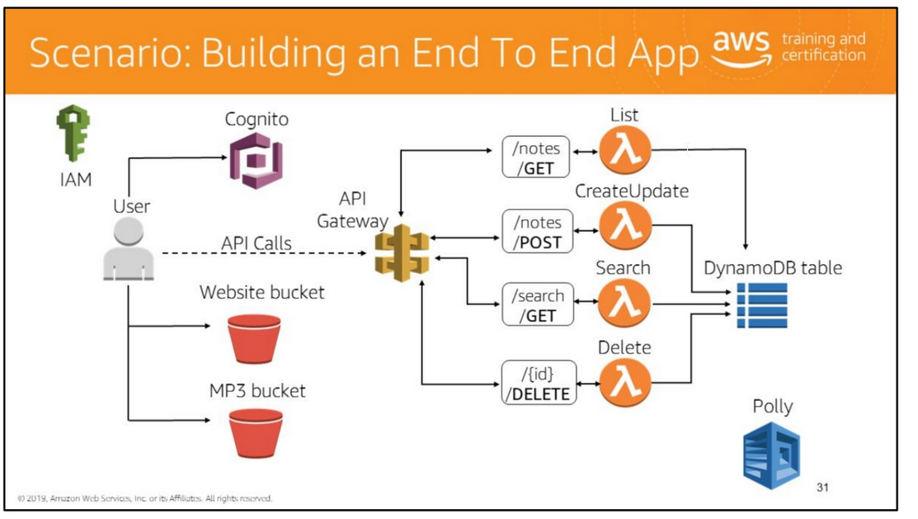
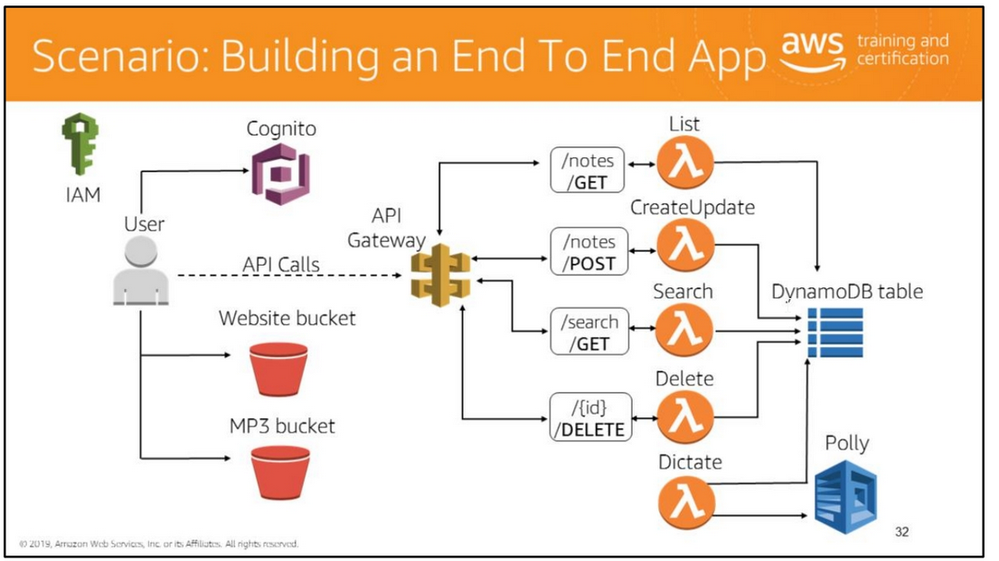
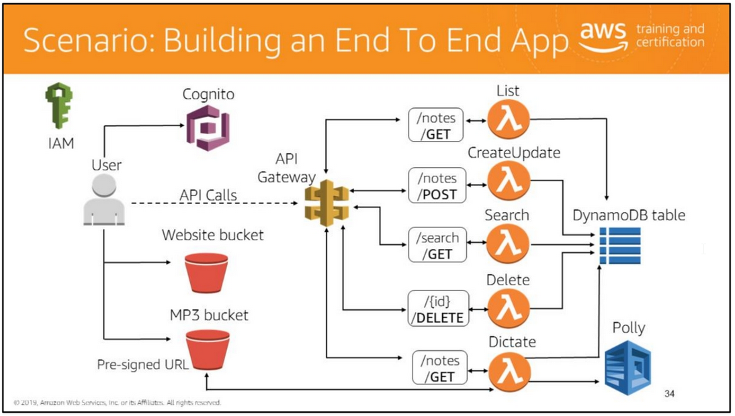

Slide 31
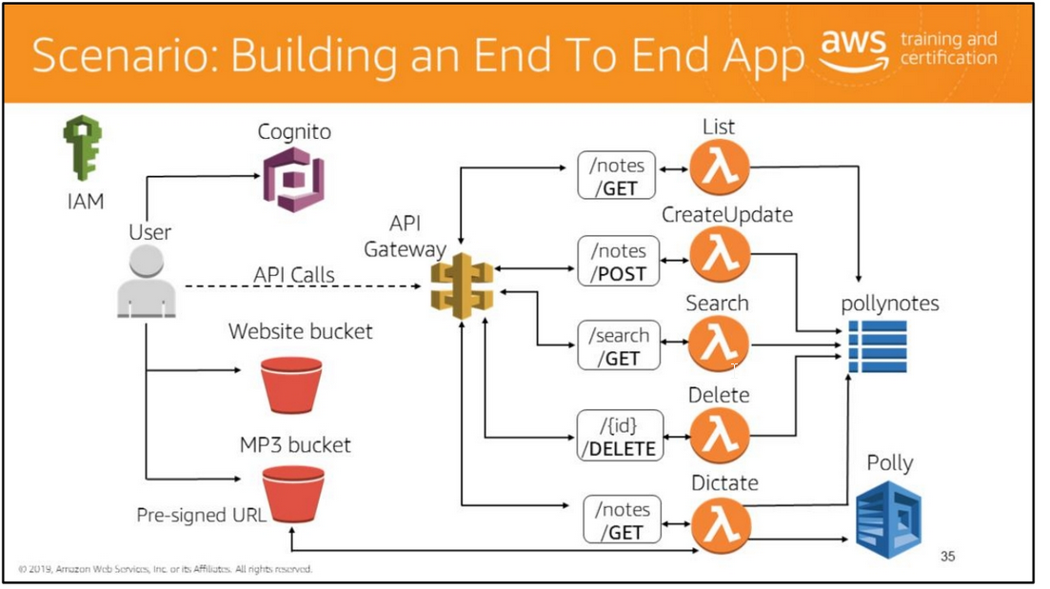

Slide 32

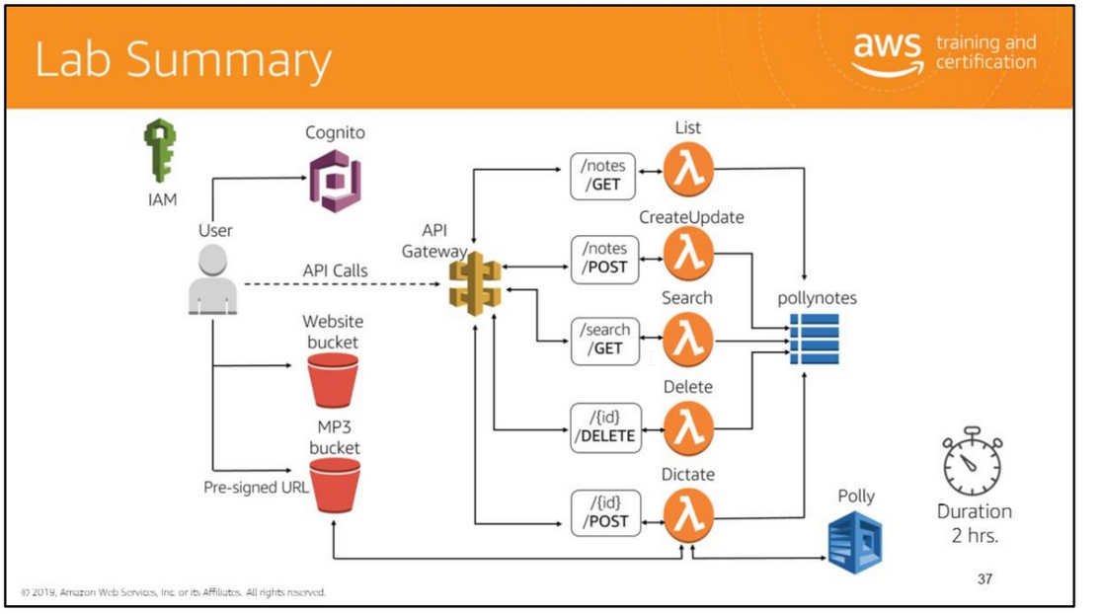
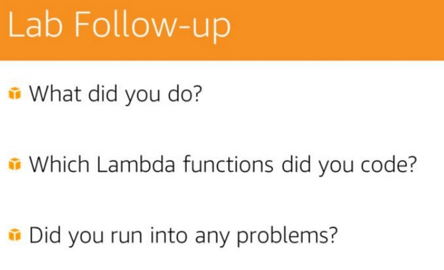
In the lab, you will:
• Create an IAM Policy and Role to give specific access to Lambda.
• Create a Cognito User Pool to authenticate users and control access to API Gateway.
• Host a Static Website in an S3 bucket.
• Create Lambda functions to perform CRUD operations on a DynamoDB table.
• Create a Restful API on API Gateway to front Lambda functions.
• Access the Polly service through API

Slide 33


